Slide 1
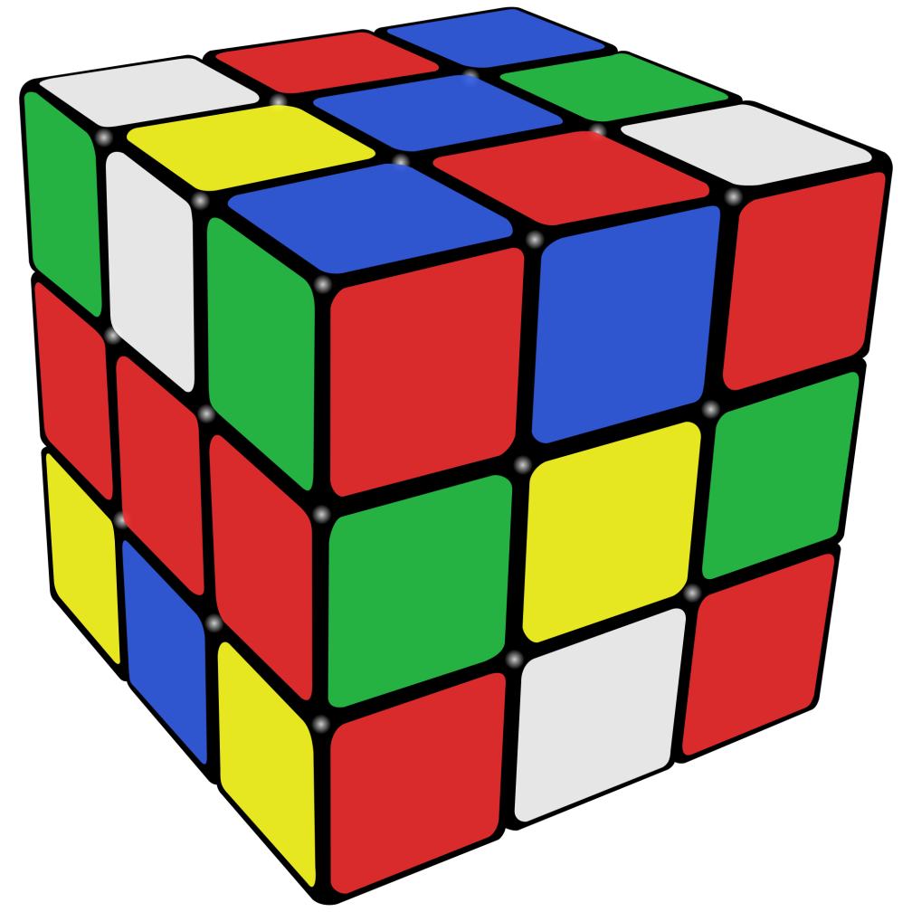
Cube Bot
Solving the Rubik's cube with robotics

Slide 2
Goals
Robot that can solve the Rubik’s cube from any given position
Acts as a reference for solving by hand

Slide 3
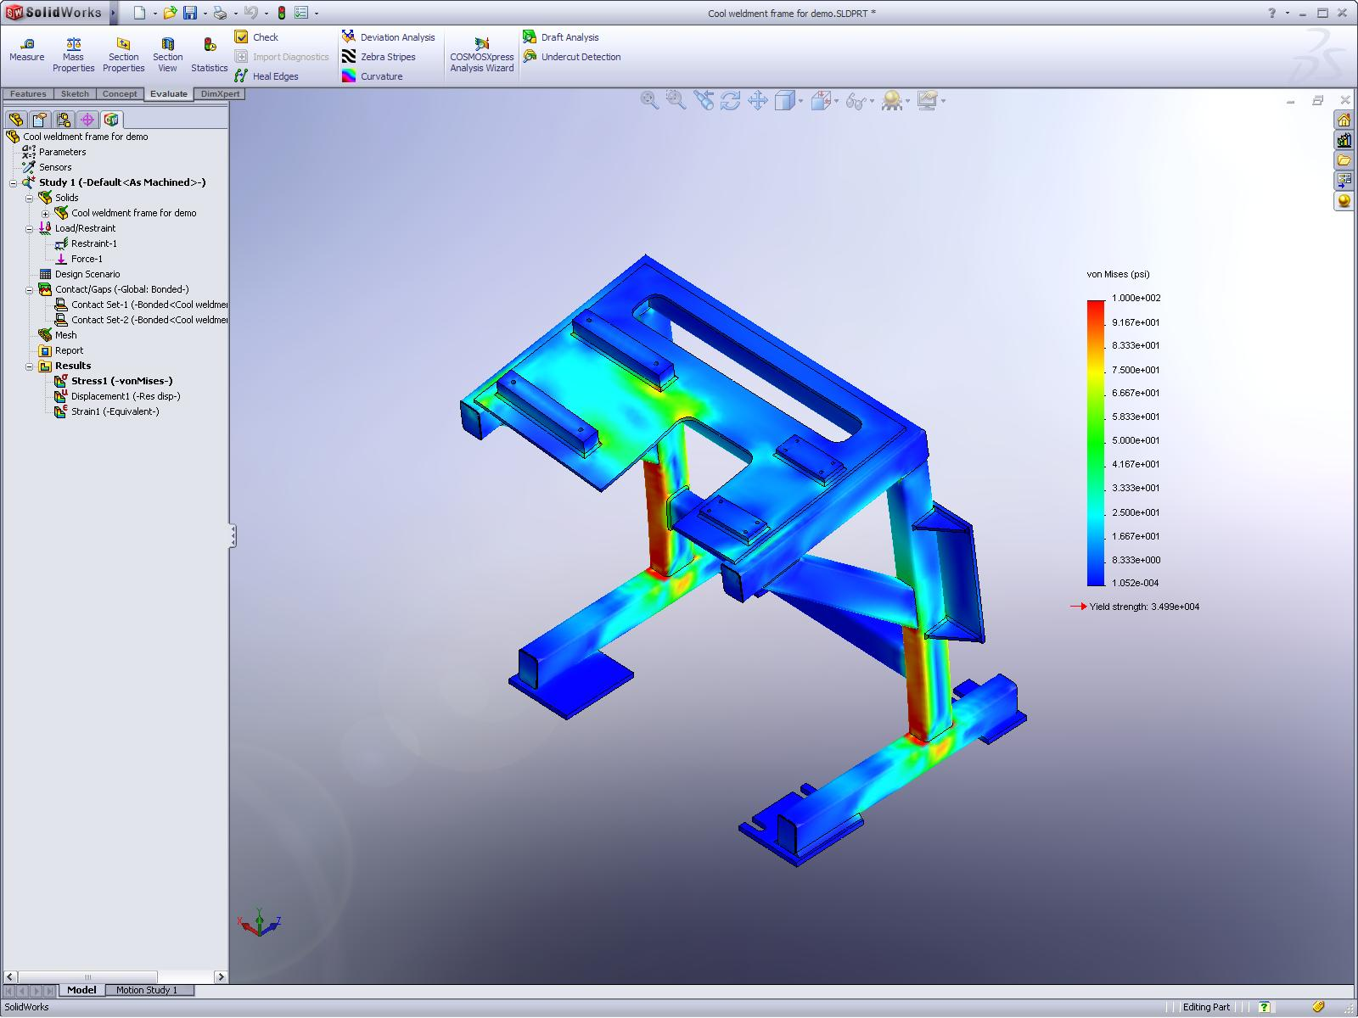
3D Modeling the frame
SolidWorks
Created base, 4 sides, and top from laser-cut acrylic

Slide 4
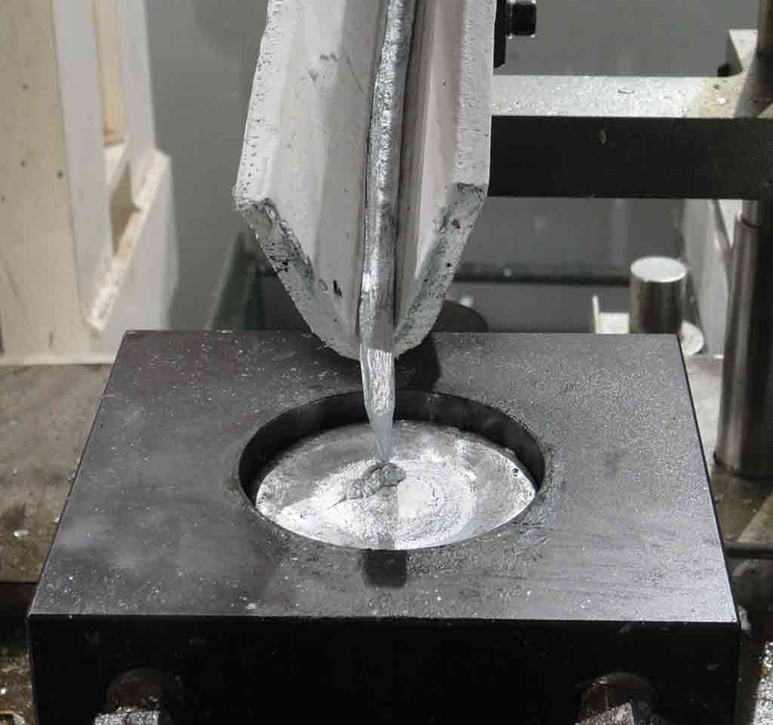
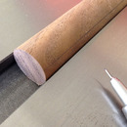
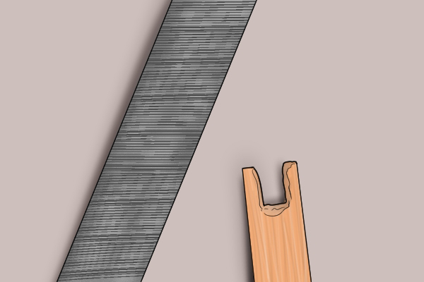
Attachments
Aluminum
Wood

Slide 5
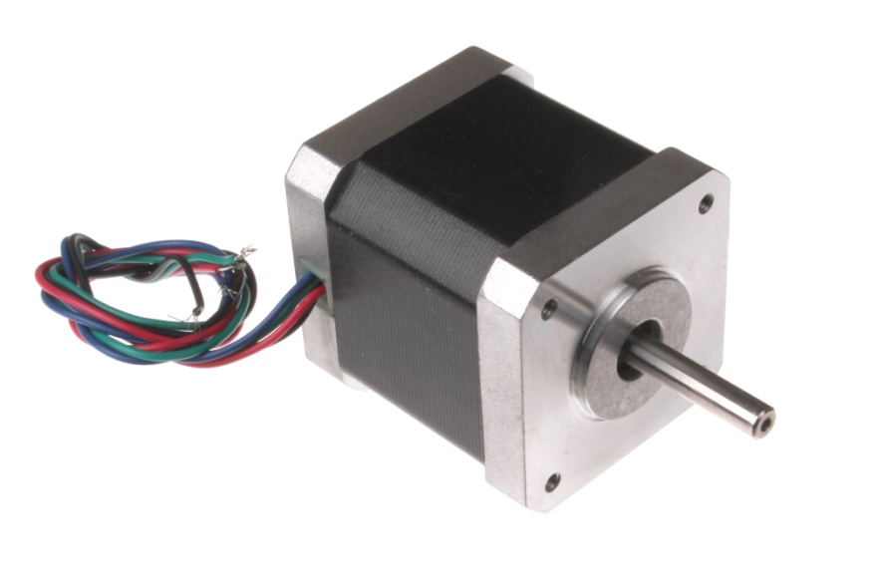
Getting Stepper Motors Running
Wiring
Challenges

Slide 6

Algorithm and Issues
God’s Algorithm
Getting algorithm to run with Processing

Slide 7
Fundamental Software Logistics
Input Combination of Faces on Cube
Solving Algorithm
Array (list)
Processing
(Move is translated into command)
Stepper Motor Turns Again
Arduino Command Code
Stepper Motor Turns
Reads next move
Repeats Process until all moves are done and cube is solved

Slide 8
Video
https://www.youtube.com/watch?v=oHNqW97JLAo

Slide 9
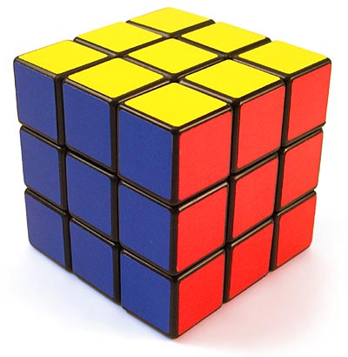
Demo
Now we will demonstrate the Rubik’s cube solving bot in action

Slide 10
Thank You

